Slide 1
Microsoft AI Challenge 2018
Akshita Parekh,CS20RESCH14001
Priya Bhatia,AI20MTECH14015

Slide 2
Problem Statement
In a dataset for each query_id and query we have 10 different passages with unique label (Binary valued label either 0 or 1) and passage_count from 0 to 9
In 10 different passages with same query_id we have only one positive label(1) and remaining nine as negative label(0).
The task is to find the relevant passage corresponding to the query entered by the user.

Slide 3
Motivation
In today’s online world of big data, users get huge amount of data corresponding to each query. Users tend to get confused which in turn ends up losing time in finding the accurate answer
An automatic web based question answering (QA) system is an important tool for improving education and e-learning. The QA system automatically returns a passage in answer to a user’s query instead of returning multiple links
Microsoft India took an initiative to evaluate the ranking of passages for a given user query namely “Microsoft AI Challenge 2018”.
We found the project very relevant to modern day scenario and daily requirement of any user surfing internet. This is really helpful in any sort of organization which is having their own networks and data repositories.

Slide 4
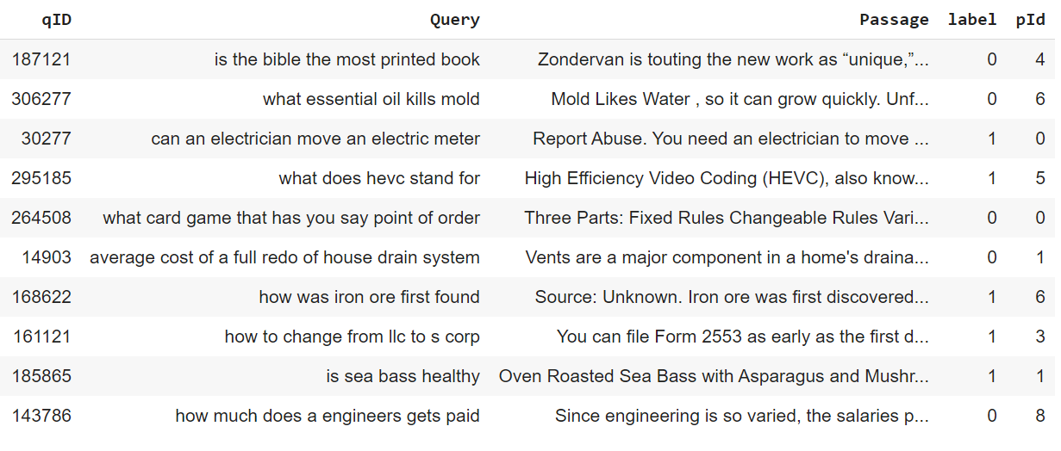
Dataset Description
In the given dataset, for each query_id and query we have 10 different passages with unique label (Binary valued label either 0 or 1) and passage_count from 0 to 9
In 10 different passages with same query_id we have only one positive label(1) and remaining 9 as negative labels(0).
Size of the dataset file is 2GB
Dataset contains the following fields :
qID
query
passage
label
pId

Slide 5
Flow Diagram
Input Dataset
Data Preparation and Pre-processing
Data Selection and Handling
Classification Model
Analysis using various metrics
Relevance
Prediction
Output

Slide 6
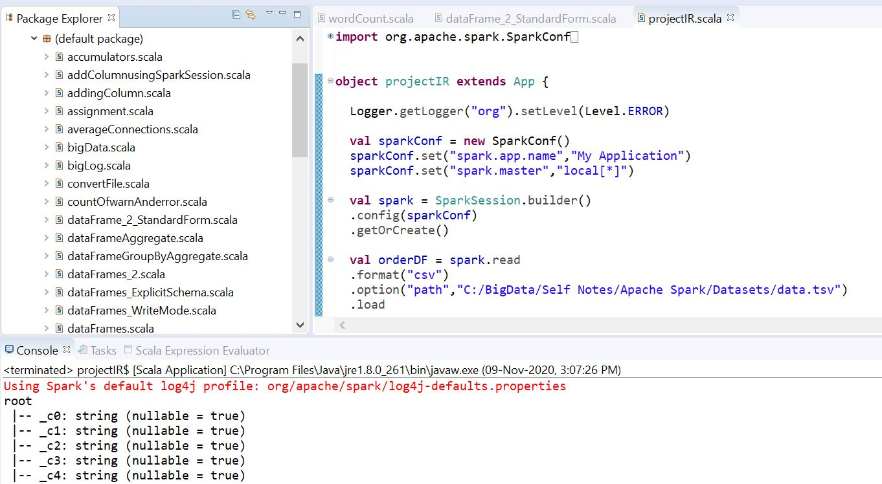
Dataset Preparation
Used Distributed Computing to handle
huge amount of dataset
Hadoop for Storage
Spark for Processing
Yarn for Resource Management
Getting sample of dataset from huge file
Spark in scala code is used for above
implementation of tasks

Slide 7
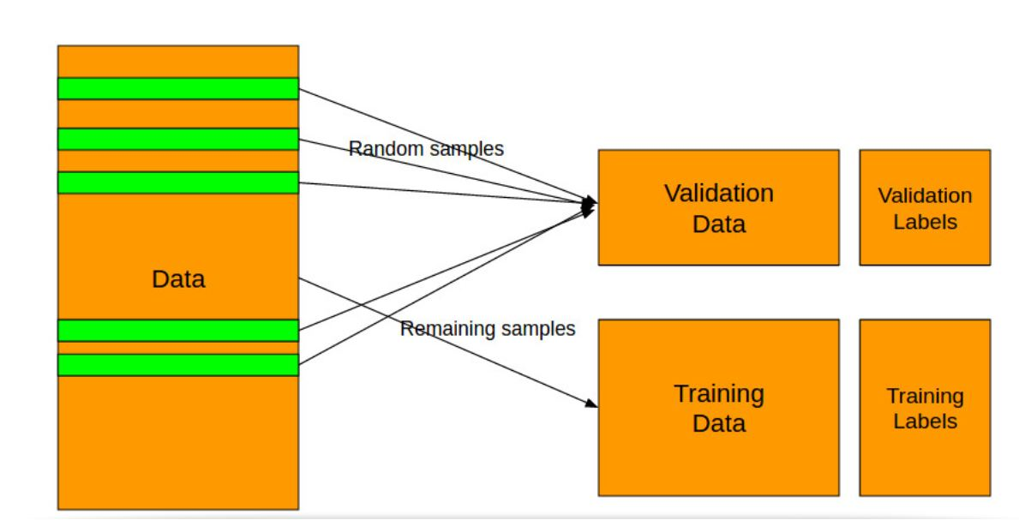
Data Selection and Handling

Slide 8
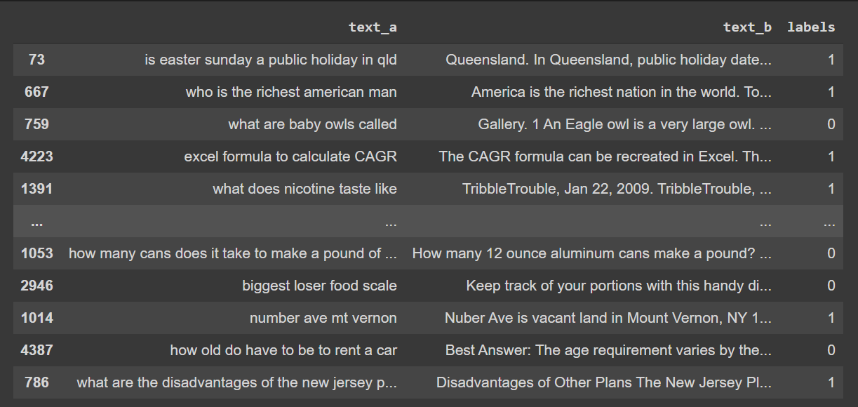
Training and Testing Data
Dataset field used for training and testing of data are:
Query (Represented by text_a in Code Demonstration)
Passage (Represented by text_b in Code Demonstration)
Label(Binary valued 0 and 1)
Positive and Negative label ratio is maintained as 50:50 to get better prediction of our model.
Ratio of 80-20 is maintained between training and testing DataFrame.

Slide 9
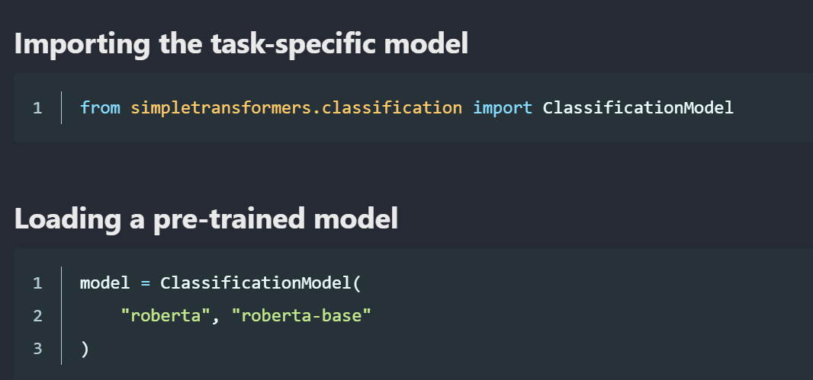
Simple Transformers
Simple Transformer models are built with a particular Natural Language Processing (NLP) task in mind. Each such model comes equipped with features and functionality designed to best fit the task that they are intended to perform. The high-level process of using Simple Transformers models follows the same pattern.
Initialize a task-specific model
To create a Task-Specific Model we need to typically
specify two things : model_type and model_name
Here, “roberta” is the model_type and
“roberta_base” is the model_name
Train the model with train_model()
Evaluate the model with eval_model()
Make predictions on(unlabelled data) with predict()

Slide 10
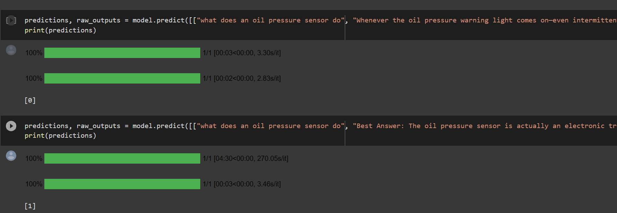
Demonstration of Predictions for the same Query and Different Passages
For the same Query : What does an oil pressure sensor do
For the different Passages : Model predicts 1 for correct one and 0 for incorrect Passage corresponding to the same query mentioned above.

Slide 11
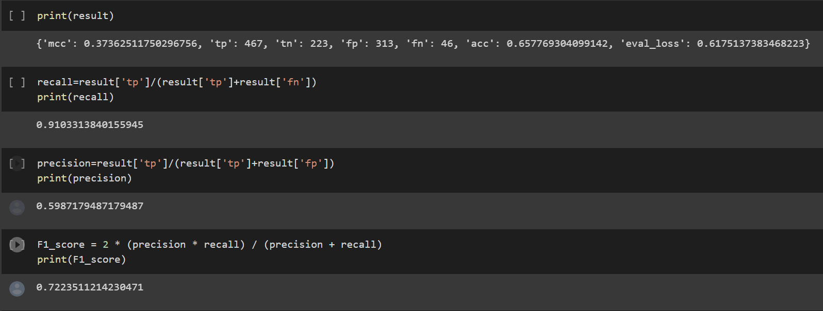
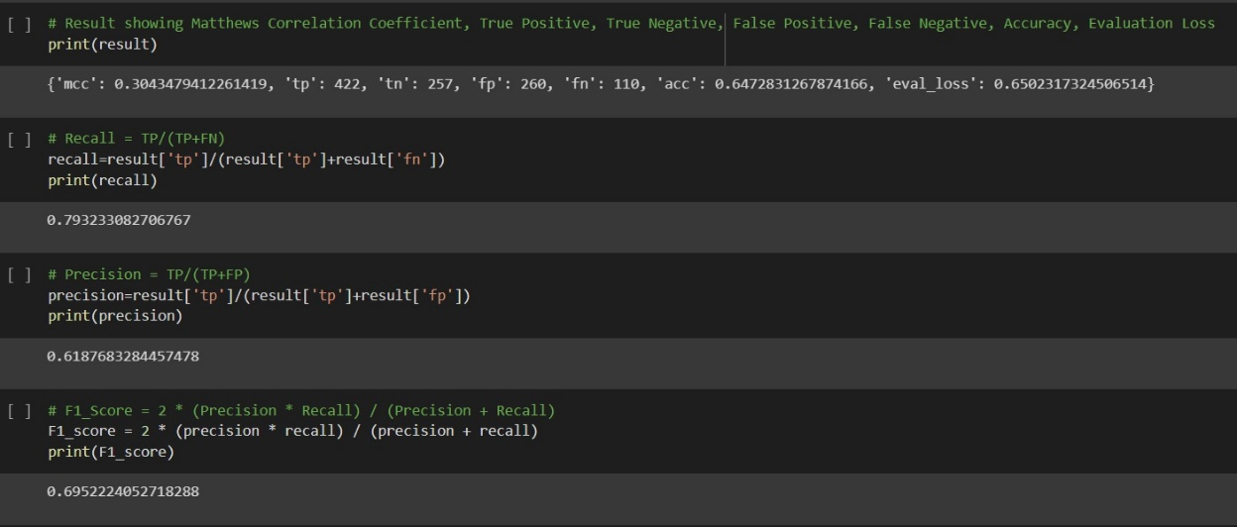
Error Analysis
#Epoch=1
#Epoch=2

Slide 12
Conclusion
After performing the complete experiment with 0.005 sample of dataset we get the following observations
Table 1 : Accuracy Metrics
We analysed that if we increase the size of the dataset and the number of epochs, the precision should further increase leading to better results.
Metrics | #EPOCH=1 | #EPOCH=2
Accuracy | 66 | 65
Precision | 60 | 62
Recall | 91 | 80
F1 Score | 72 | 70

Slide 13
Thank you!!

